Slide 1
Boutique Shampoo Ltd
ANALYSIS OF THE EFFECTIVENESS OF VARIOUS MARKETING EFFORTS IN DRIVING SALES.

Slide 2
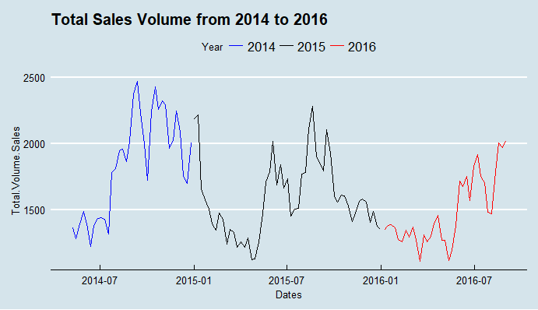
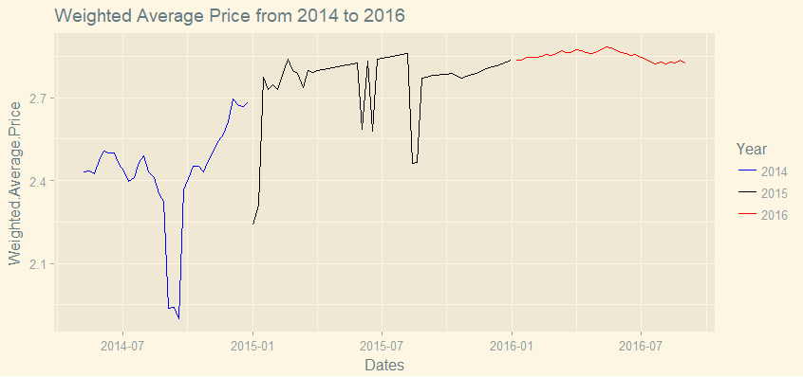
Part 1: Analysis
Timeline 2014-2016:
Highest sales recorded on 11/09/2014 .
Lowest sales recorded on 17/03/2016.
2014:
Highest sales :2467.5 units on 11/09/2014
Lowest sales :1221.3 units on 12/06/2014
2015:
Highest sales :2279.6 units on 20/08/2015
Lowest sales :1122.3 units on 23/04/2015
2016:
Highest sales :2015.8 units on 01/09/2016
Lowest sales :1111.6 units on 17/-03-2016
Notes:
Here, I made a time series analysis(in R), to see the variation and fluctuation is average price and sales volume overtime

Slide 3
Data Overview:
 | Total Volume Sales | Total Value Sales | Weighted Average Price | Distribution | Price Promotion 1 | Price Promotion 2 | On pack Promo Offer | Rebrand | TV | Radio | Press | Outdoor | Online
count | 122.0 | 122.0 | 122.0 | 122.0 | 122.0 | 122.0 | 122.0 | 122.0 | 122.0 | 122.0 | 122.0 | 122.0 | 122.0
mean | 1628.8 | 4350.9 | 2.7 | 82.6 | 0.0 | 0.0 | 0.0 | 0.8 | 28.2 | 3.6 | 9.5 | 5.0 | 4824.1
std | 335.6 | 746.1 | 0.2 | 0.5 | 0.2 | 0.2 | 0.2 | 0.4 | 45.5 | 15.6 | 21.2 | 22.5 | 2645.9
min | 1111.6 | 3054.6 | 1.9 | 81.5 | 0.0 | 0.0 | 0.0 | 0.0 | 0.0 | 0.0 | 0.0 | 0.0 | 245.0
25% | 1365.6 | 3713.0 | 2.5 | 82.3 | 0.0 | 0.0 | 0.0 | 1.0 | 0.0 | 0.0 | 0.0 | 0.0 | 2501.5
50% | 1554.4 | 4289.5 | 2.8 | 82.7 | 0.0 | 0.0 | 0.0 | 1.0 | 0.0 | 0.0 | 0.0 | 0.0 | 5546.5
75% | 1851.5 | 4921.0 | 2.8 | 83.0 | 0.0 | 0.0 | 0.0 | 1.0 | 75.0 | 0.0 | 0.0 | 0.0 | 6807.1
max | 2467.5 | 5951.4 | 2.9 | 84.1 | 1.0 | 1.0 | 1.0 | 1.0 | 141.0 | 99.0 | 84.0 | 125.0 | 9618.3
Notes:
A summary descriptive statistics done in Python and table created in MS Word.

Slide 4
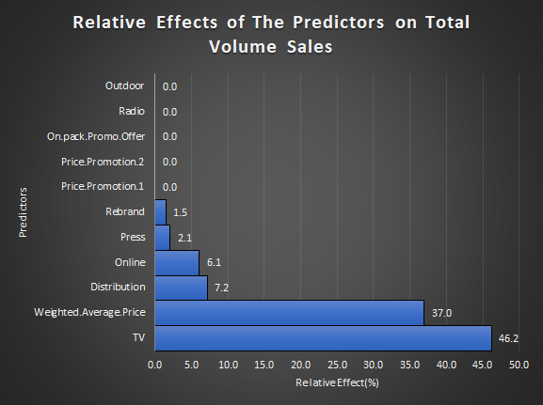
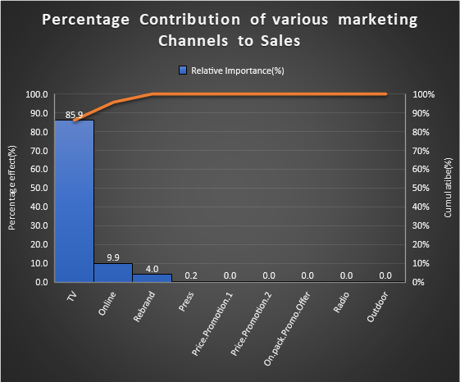
Effects of Various Marketing Channels on Sales
Notes:
In deriving the relative effects of marketing channels and all predictors, I chose the regression boosted tree method because it combines machine learning and statistical learning to give useful insights. I did this in R with the dismo and gbm packages(for cross checking). I then used the optimal iteration to get the estimation with least error. Afterwards, I collected the summary of relative importance and made the visualisations in Excel.

Slide 5
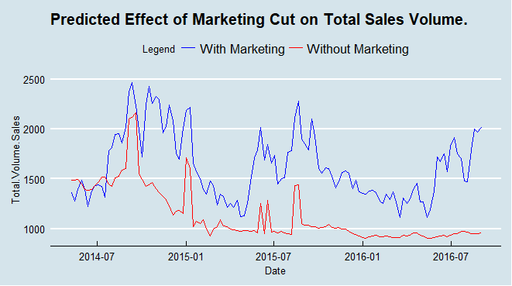
Probable Scenario if Baseline Sales is Adopted:
If all marketing activities are stopped and distribution remains at 83.06 units and the weighted average price at 2.82, sales volume could drop to as low as about 955.4 from 2015.8 units which was recorded on 2016-09-01. This would be about a 100% decrease.
Notes:
I adopted the Generalised Linear model(which is a better version of the basic Linear model because it does not require transformation of response variables via log, logit, or gaussian functions). Afterwards, I built the model and predicted Total Sales volume when all marketing efforts are zero(i.e cut off). Based on this, I made a time series comparing the baseline sales on the original sales. This were all done in R(including the visualisation).

Slide 6
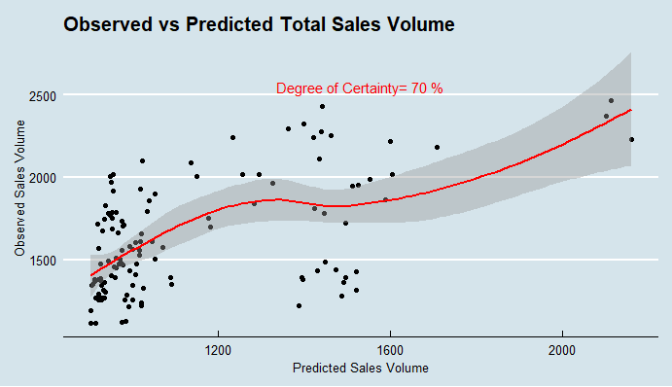
Results Certainty:
The results are based on 70% level of certainty.
However, all the predictors accounted for about 76% of the variation in sales. Therefore, 24% variation remain unexplained. Other probable predictors might include:
Competition:
it is important to consider the prices of alternative products(absolute).
Comparison of your profit margin against your competition’s profit margin(absolute value).
Percentage Share of shelf(relative):e.g, 30%,50% etc?
2. Brand ambassador of the brand(Nominal): either the person her/himself(personality) or Gender?.
3. Channel-strategy(i.e. Demography of Target consumers. e.g. purchasing power and location). This could be ordinal. E.g. Low, Middle, or High.
4. Climatic data: seasonal variation(winter, summer e.t.c) or weather.
Notes:
After attempting, the Leave-One-Out cross validation and 70:30 sample splitting, I chose the latter.
I divided the data into 70 calibration/training set and 30% evaluation/testing set. This was then bootstrapped 2000 times(i.e sampled with replacement 2000 times), to derive the correlations of the predicted with the observed. Each of the 2000 correlations were then squared. The mean value was chosen and multiplied by 100 to give the degree of certainty. I did the same for Generalized additive model and regression boosted tree but chose the Generalised Linear Model because it was the best. This was done in R.
Secondly, the 76% explanation of sales variation by predictors was derived from the deviance explained in the summary model of GLM with the formula : Explained deviance (D-squared) = (Null deviance – Residual deviance) / Null deviance

Slide 7
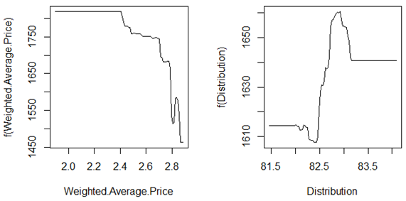
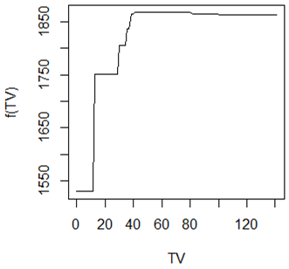
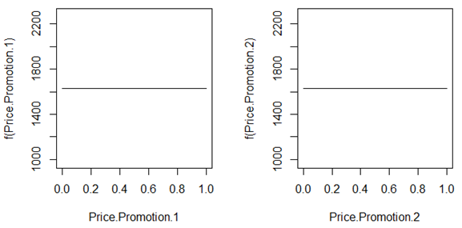
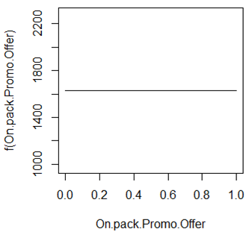
How Sales respond to the predictors
Notes:
The response curves were output from the regression boosted trees by plotting the variable effect at best iteration.

Slide 8
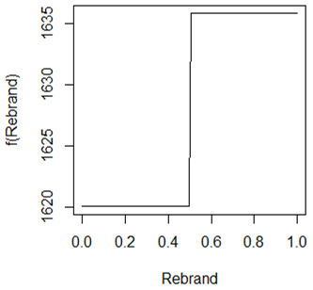
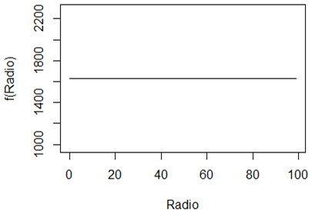
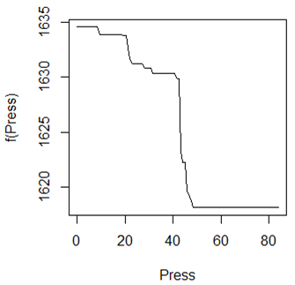
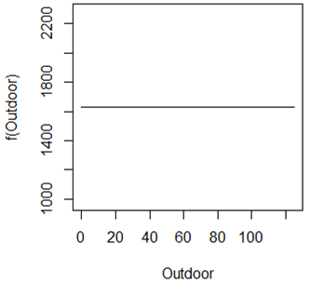
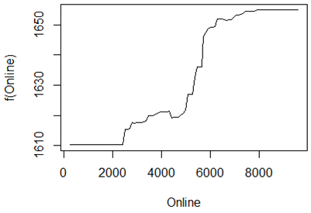

Slide 9
Part 2: Conclusions, Recommendations, additional findings.
TV, online activities and rebranding are the major marketing activities that affect your sales positively.
Press has negative effect, although not too much. Price promotions 1 and 2 have no effect on sales.
Radio has no effect. Likely reason could be because Shampoo is a beauty product which is visual and radio is just audio without visuals and cannot adequately communicate effect.
On-pack promo offer also has no effect probably because, it is a beauty product and may not sufficiently incentivise consumers to experiment with it. Based on experience, beauty products are mainly purchased based on recommendation or persuasion. Persuasion can be done by canvassers, brand ambassador, acquaintances’ testimonies, visual advert(video or photograph e.g billboard, video ads), etc.
Outdoor marketing: This has no considerable effect on the sales. However, it could be, depending on effectiveness, location, Time( work-hour period or off-time? Season? e.g summer holiday? Weekend? Winter?), appropriateness of the outdoor event, audience(demographics?)

Slide 10
Recommendations:
Any other rebranding activity can be put on hold, as it does not greatly impact the total sales volume.
Effort should be put into building present brand as it is.
Online activities should be maintained.
TV activities can be reduced to about 60 units as it does not have considerable positive effect from about 50 unit. The excess from this could be reinvested into sustaining online activities or brand ambassador and price subsidy/reduction. Sales drops when price is over 2.4 units and even more drastic when more than 2.7 unit.
However, TV activities should still be retained, as it is very significant because it has visuals and audio..
Although, press activities effect is negative on the total sales volume, the degree of effect is not significant. Nevertheless, efforts should be put into maintaining positive press image and minimising negative reviews.
Products should be properly and effectively distributed. Efforts should be focused on more important outlets.

